Slide 1
MODULE III
Data Modeling and Relationships

Slide 2
Module Summary
Entity relationship model; relational data model; entity types, entity subtypes
CASE Modeling Tools
Entity relationship modeling (E-R diagrams)
Relationships types:
- 1:1 relationships
- 1:N relationships
- M:N relationships
- Attributes and constraints
Model structure relation
Transforming E-R diagrams into relations

Slide 3
Entity relationship model
Entity Relationship Model (ER Modeling) is a graphical approach to database design. It is a high-level data model that defines data elements and their relationship for a specified software system.
An ER model is used to represent real-world objects.
ER model stands for an Entity-Relationship model. It is a high-level data model. This model is used to define the data elements and relationship for a specified system.
It develops a conceptual design for the database. It also develops a very simple and easy to design view of data.
In ER modeling, the database structure is portrayed as a diagram called an entity-relationship diagram.

Slide 4
Components of ER Diagram
1. Entity:
An entity may be any object, class, person or place. In the ER diagram, an entity can be represented as rectangles.
Consider an organization as an example- manager, product, employee, department etc. can be taken as an entity.
2. Attribute
The attribute is used to describe the property of an entity. Eclipse is used to represent an attribute.
For example, id, age, contact number, name, etc. can be attributes of a student.
3. Relationship
A relationship is used to describe the relation between entities. Diamond or rhombus is used to represent the relationship.

Slide 5
Types of relationship
a. One-to-One Relationship
When only one instance of an entity is associated with the relationship, then it is known as one to one relationship.
For example, A female can marry to one male, and a male can marry to one female.
b. One-to-many relationship
When only one instance of the entity on the left, and more than one instance of an entity on the right associates with the relationship then this is known as a one-to-many relationship.
For example, Scientist can invent many inventions, but the invention is done by the only specific scientist.

Slide 6
Types of relationship
c. Many-to-one relationship
When more than one instance of the entity on the left, and only one instance of an entity on the right associates with the relationship then it is known as a many-to-one relationship.
For example, Student enrolls for only one course, but a course can have many students.
d. Many-to-many relationship
When more than one instance of the entity on the left, and more than one instance of an entity on the right associates with the relationship then it is known as a many-to-many relationship.
For example, Employee can assign by many projects and project can have many employees.

Slide 7
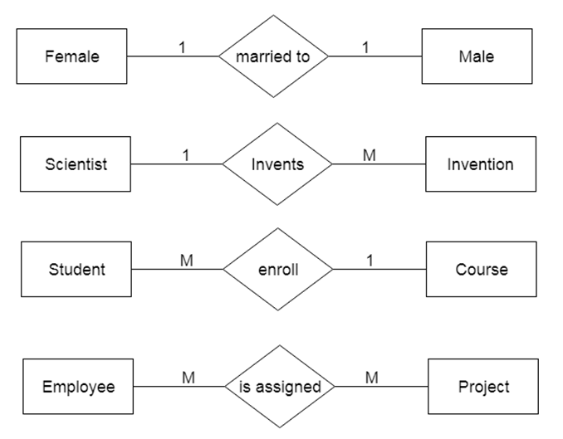
Relationship examples

Slide 8
Attributes and constraints
Constraints enforce limits to the data or type of data that can be inserted/updated/deleted from a table.
The whole purpose of constraints is to maintain the data integrity during an update/delete/insert into a table.
Types of constraints
- NOT NULL
- UNIQUE
- DEFAULT
- CHECK
- Key Constraints – PRIMARY KEY, FOREIGN KEY

Slide 9
Attributes and constraints
NOT NULL:
NOT NULL constraint makes sure that a column does not hold NULL value. When we don’t provide value for a particular column while inserting a record into a table, it takes NULL value by default. By specifying NULL constraint, we can be sure that a particular column(s) cannot have NULL values.
UNIQUE:
UNIQUE Constraint enforces a column or set of columns to have unique values. If a column has a unique constraint, it means that particular column cannot have duplicate values in a table.
DEFAULT:
The DEFAULT constraint provides a default value to a column when there is no value provided while inserting a record into a table.

Slide 10
Attributes and constraints
CHECK:
This constraint is used for specifying range of values for a particular column of a table. When this constraint is being set on a column, it ensures that the specified column must have the value falling in the specified range.
Key constraints:
PRIMARY KEY:
Primary key uniquely identifies each record in a table. It must have unique values and cannot contain nulls. In the below example the ROLL_NO field is marked as primary key, that means the ROLL_NO field cannot have duplicate and null values.
FOREIGN KEY:
Foreign keys are the columns of a table that points to the primary key of another table. They act as a cross-reference between tables.

Slide 11
Model structure relation
Relational Model Concepts
Attribute: Each column in a Table. Attributes are the properties which define a relation. e.g., Student Rollno, NAME,etc.
Tables – In the Relational model the, relations are saved in the table format. It is stored along with its entities. A table has two properties rows and columns. Rows represent records and columns represent attributes.
Tuple – It is nothing but a single row of a table, which contains a single record.
Relation Schema: A relation schema represents the name of the relation with its attributes.
Degree: The total number of attributes present in the table which in the relation is called the degree of the relation.
Cardinality: Total number of rows present in the Table.
Column: The column represents the set of values for a specific attribute.
Relation instance – Relation instance is a finite set of tuples in the RDBMS system. Relation instances never have duplicate tuples.
Relation key - Every row has one, two or multiple attributes, which is called relation key.
Attribute domain – Every attribute has some pre-defined value and scope which is known as attribute domain.

Slide 12
Types of attributes
Simple attribute :
An attribute that cannot be further subdivided into components is a simple attribute. Example: The roll number of a student, the id number of an employee.
Composite attribute :
An attribute that can be split into components is a composite attribute.
Example: The address can be further split into house number, street number, city, state, country, and pin code, the name can also be split into first name middle name, and last name.
Single-valued attribute :
The attribute which takes up only a single value for each entity instance is a single-valued attribute.
Example: The age of a student.
Multi-valued attribute :
The attribute which takes up more than a single value for each entity instance is a multi-valued attribute.
Example: Phone number of a student: Landline and mobile.

Slide 13
Types of attributes
Derived attribute :
An attribute that can be derived from other attributes is derived attributes.
Example: Total and average marks of a student.
Stored attribute:
The stored attribute are those attribute which doesn’t require any type of further update since they are stored in the database.
Example: DOB(Date of birth) is the stored attribute.
Key attribute:
Key attributes are those attributes that can uniquely identify the entity in the entity set.
Example: Roll-No is the key attribute because it can uniquely identify the student.

Slide 14
Types of attributes
Null Attribute:
This attribute can take NULL value when entity does not have value for it.
Example:
The ‘Net Banking Active Bin’ attribute gives weather particular customer having net banking facility activated or not activated.
For bank which does not offer facility of net banking in customer table ‘Net Banking Active Bin’ attribute is always null till Net banking facility is not activated as this attribute indicates Bank offers net banking facility or does not offers.

Slide 15
Types of DBMS Entities
The following are the types of entities in DBMS −
Strong Entity
The strong entity has a primary key. Weak entities are dependent on strong entity. Its existence is not dependent on any other entity.
Strong Entity is represented by a single rectangle −
Professor is a strong entity here, and the primary key is Professor_ID.
Weak Entity
The weak entity in DBMS do not have a primary key and are dependent on the parent entity. It mainly depends on other entities.
Weak Entity is represented by double rectangle −
Continuing our previous example, Professor is a strong entity, and the primary key is Professor_ID. However, another entity is Professor_Dependents, which is our Weak Entity.
This is a weak entity since its existence is dependent on another entity Professor, which we saw above. A Professor has Dependents.
The Strong Entity is Professor, whereas Dependent is a Weak Entity.

